Slide 1

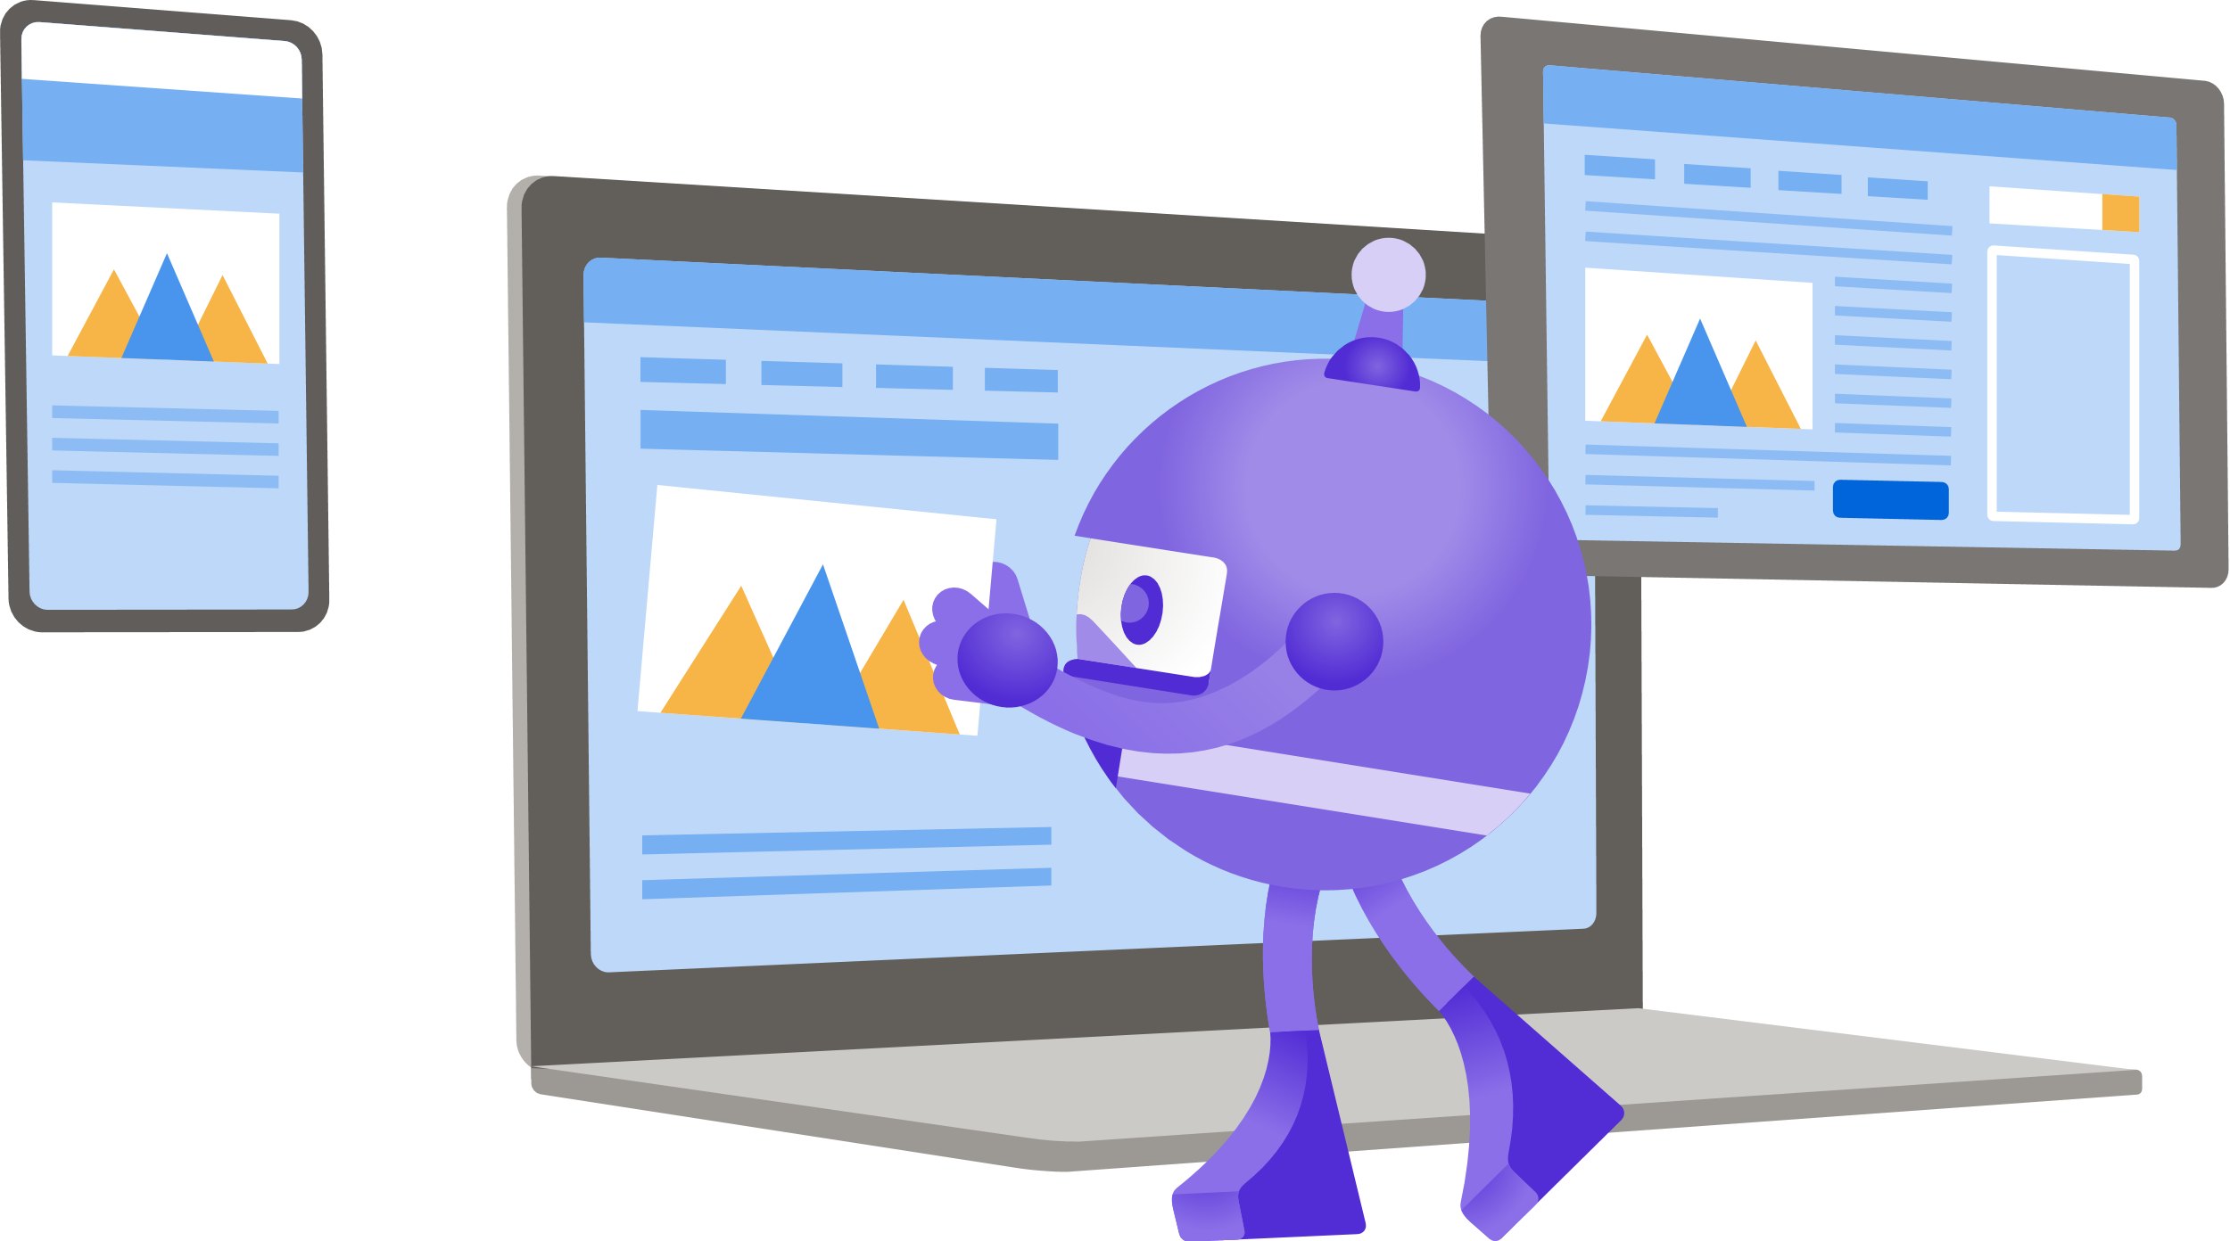
Authenticate users and call protected APIs in your MAUI app
Sameer Khandekar

Slide 2
History of Authentication
Store username and password
Plain text
Problem: No way to get data from the 3rd party other than store as plain text

Slide 3
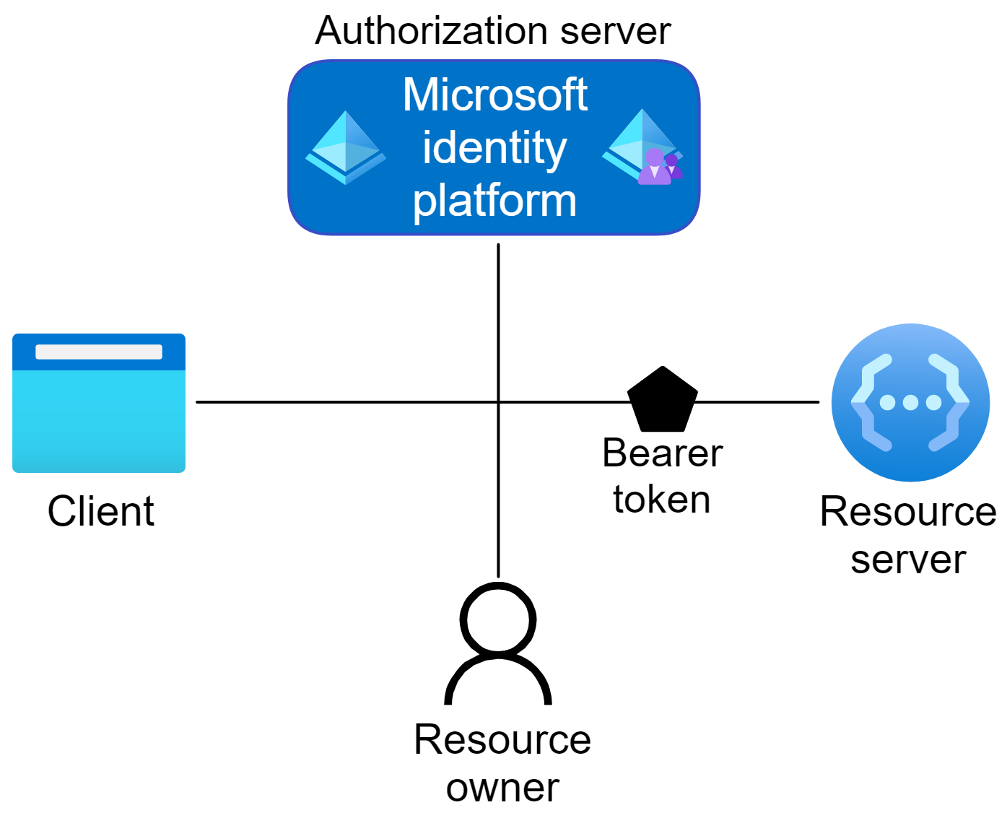
What is OAuth 2.0 & OpenID Connect (OIDC)
High Level
Scoped Access to resource
Private dialog between Authorization Server and User
Token Types
AT, RT
IdToken
Notes:
Client – The mobile app
Resource Owner – End user
Authorization Server - aka Identity Provider or IdP
Resource server – hosts protected API, validates token

Slide 4
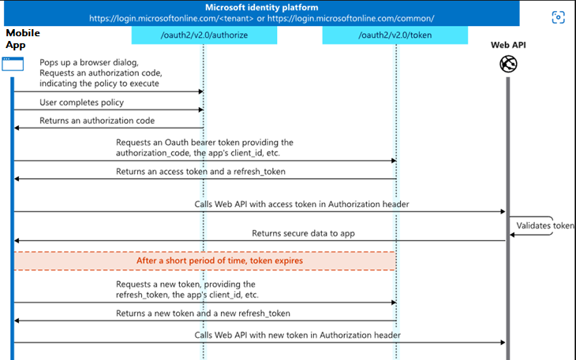
Authorization Code Flow

Slide 5
MSAL.NET made it simple
Configuration in Portal
https://aka.ms/mobile-app-reg
Public Client – Desktop Apps, Mobile Apps
Corporate Accounts (Azure Active Directory)
Personal Accounts (B2C e.g. Facebook, Google, Microsoft Personal Account)
Code – Only 3 cross platform steps
Create the PublicClientApplication
Call AcquireTokenSilent
If it requires UI, call AcquireTokenInteractive
Platform specific code + redirect URIs

Slide 6

Demos
Maui Basic App
Maui App With Broker
Maui B2C App
Location: https://github.com/AzureAD/microsoft-authentication-library-for-dotnet/tree/main/tests/devapps/MauiApps

Slide 7
References
NuGet - https://www.nuget.org/packages/Microsoft.Identity.Client/
GitHub - https://github.com/AzureAD/microsoft-authentication-library-for-dotnet
Maui Status - https://github.com/AzureAD/microsoft-authentication-library-for-dotnet/blob/main/MauiStatus.md
Maui DevApps - https://github.com/AzureAD/microsoft-authentication-library-for-dotnet/tree/main/tests/devapps/MauiApps
Maui DevOps - https://devblogs.microsoft.com/dotnet/devops-for-dotnet-maui/
MSAL samples - https://docs.microsoft.com/en-us/azure/active-directory/develop/sample-v2-code
App Types and Auth Flows - https://docs.microsoft.com/en-us/azure/active-directory/develop/authentication-flows-app-scenarios

Slide 8

Thanks for joining!
Ask your questions live on Twitter #dotNETConf

Slide 9
Consolidated code changes in the next slides.

Slide 10
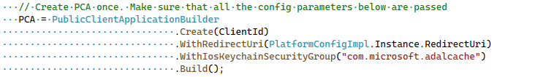
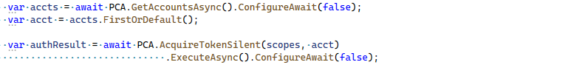
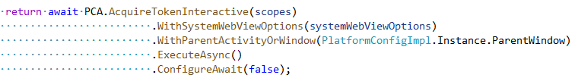
Cross Platform Code
Create the PublicClientApplication
Call AcquireTokenSilent
If it requires UI, call AcquireTokenInteractive

Slide 11
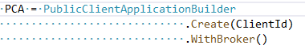

Tweaks for Broker and B2C
Broker
Create - Add WithBroker.
Interactive – Keep WithSystemWebViewOptions/WithUseEmbeddedView Used when broker is not available.
B2C
Create – Add WithB2CAuthority
Silent – Add WithB2CAuthority
WithBroker is not applicable
Google B2C does not support Embedded View

Slide 12
Cross Platform Code – Maui Difference
Project structure
Will show in the code
Internal change: AesManaged -> Aes

Slide 13
Android Changes
AndroidManifest.xml
Add BrowserTabActivity and MsalActivity as respondent to redirect URI
MainActivity.cs
OnCreate
OnActivityResult
MsalActivity.cs
For non broker only

Slide 14
Android Code – Maui Difference
Internal: AndroidClientHandler -> AndroidMessageHandler
Add [Activity(Exported =true)] to Activity

Slide 15
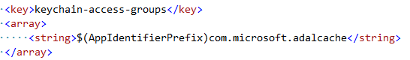
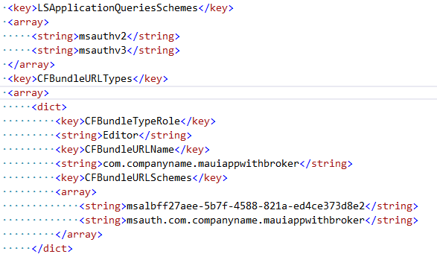
iOS Changes
AppDelegate.cs
Configure Redirect URI
Broker Override OpentURL – Continue with AuthenticationContinuationHelper
Entitlements.plist
Add
Info.plist
Broker – Add
LSApplicationQueriesSchemes,
and CFBundleURLTypes

Slide 16
iOS Changes - Maui Difference
AppDelegate:: OpenUrl no pointer to the sourceApplication
Specify min iOS in the project

